Slide 1
Drawing Weekly Outline:
Days 1-2:
  PowerPoint and Notes- fill out in class and on your own if needed
  “tactile” experiences with a variety of drawing materials
Day 3 – Quiz covering art elements and principles relating to 2-D work and 3-D work (tying into last weeks studies).

Slide 2
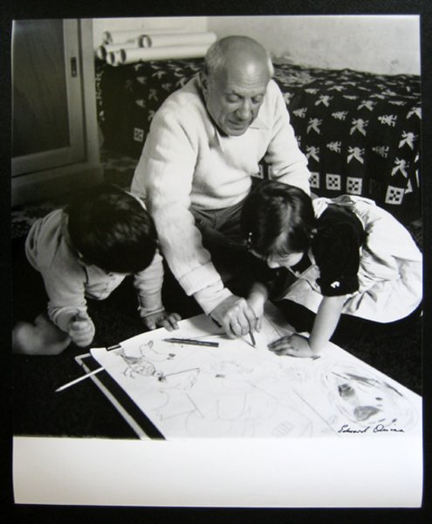
Drawing
Artists and their contributions

Slide 3
Drawing
2 Qualities often associated with drawing:
Familiarity- familiar art materials- pencils, pens, ink, and other items we easily understand as viewers
Intimacy- drawings are usually not intended for public viewing. Generally, these are smaller works of art, and often are found in sketchbooks. Often these are made in preparation for larger, final works.
Pablo Picasso, mindful of his own legacy, recognized these traits early on in his career, and began to date and save all of his sketches.

Slide 4
Artists and their contributions to the media of drawing…
Take note of Artist Name
Take note of Drawing Media used
Take note of the Title of the piece
Take note of the Year the piece was made

Slide 5
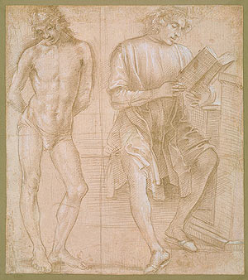
Filippino Lippi (c. 1480)
Standing Nude and Seated Man Reading metalpoint and white chalk
MetalPoint Demonstration

Slide 6
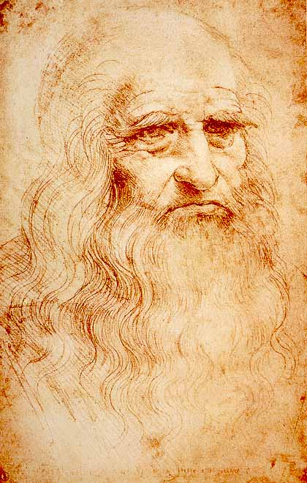
Leonardo DaVinci (c. 1512)
Self Portrait red chalk and pen

Slide 7
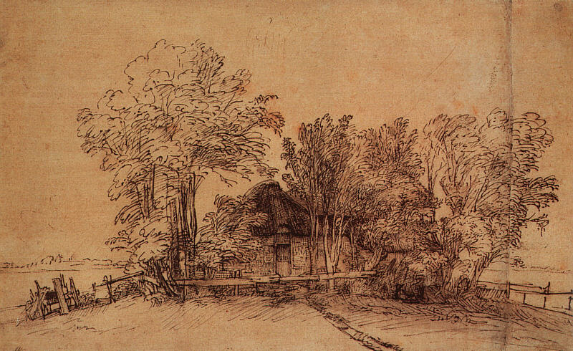
Rembrandt (1648)
Cottage Among Trees pen and brown ink

Slide 8
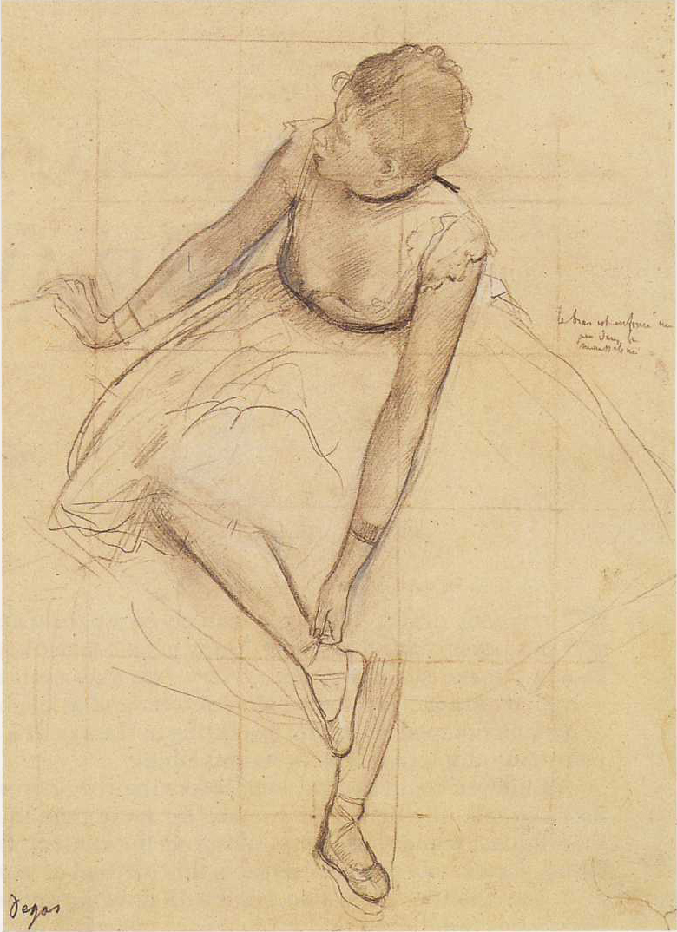
Edgar Degas (1873)
Dancer Adjusting her Slippers graphite and charcoal

Slide 9
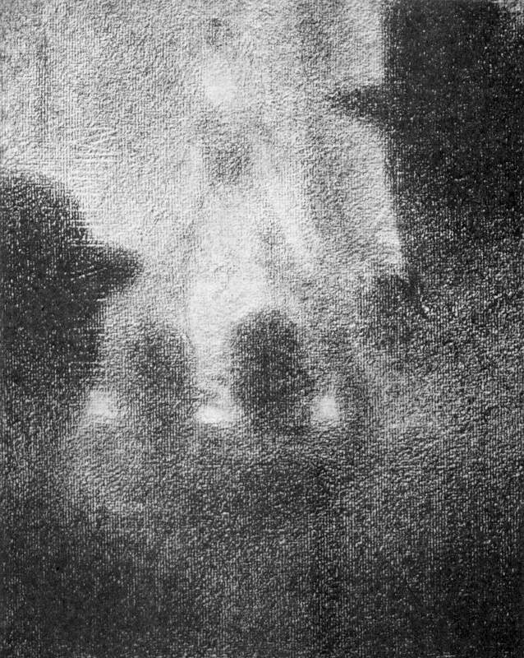
Georges Seurat (c. 1887)
Café Concert conte crayon

Slide 10
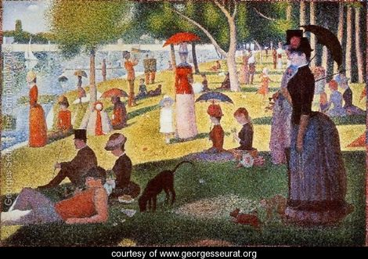

Slide 11
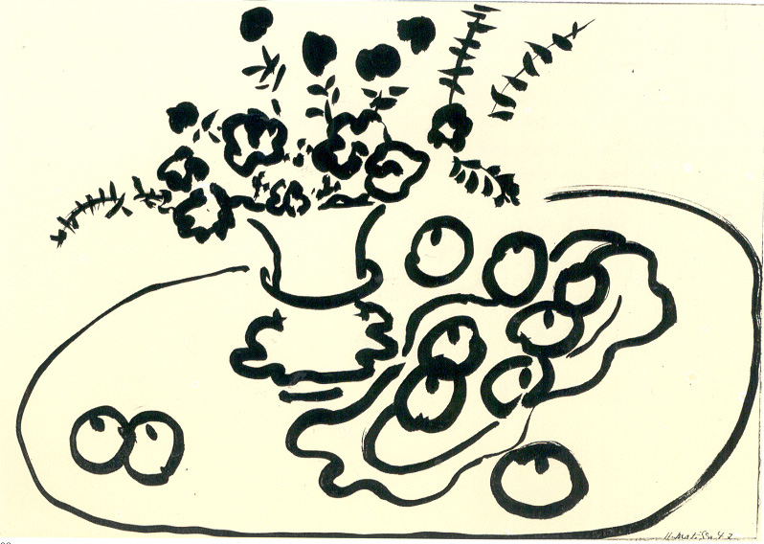
Henri Matisse (1947)
Still Life of Flowers and Fruit brush and ink

Slide 12
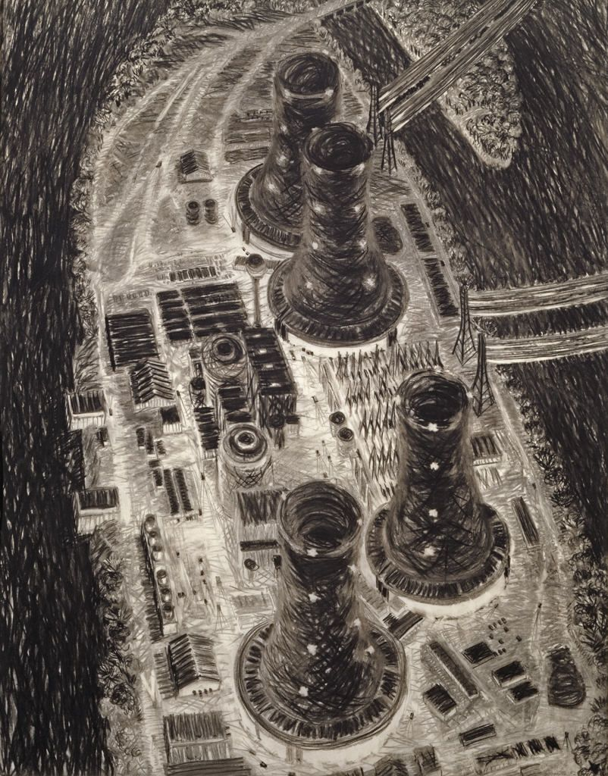
Yvonne Jacquette (1982)
3 Mile Island, Night I charcoal

Slide 13
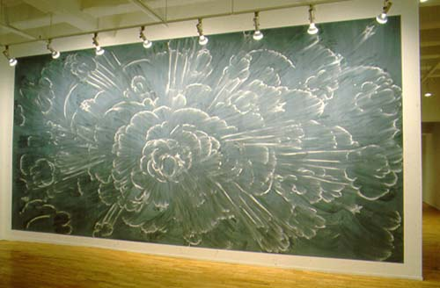
Gary Simmons (1996)
Boom
Chalk
(click on image for video)

Slide 14
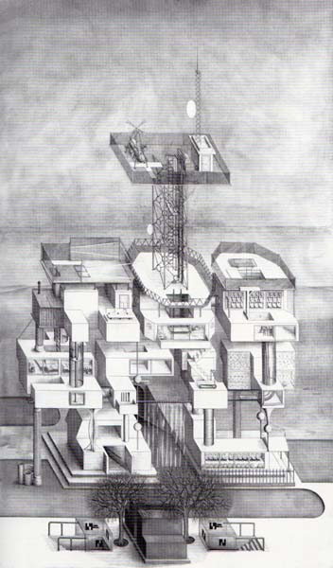
Paul Noble (1997)
Nobspital pencil
(click on image for video)

Slide 15
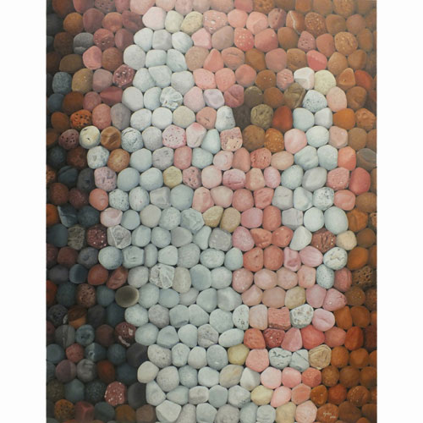
Scott Krohn (2014)
Stone Faced: Self-Portrait colored pencil
Colored Pencil Society of America Best of Show

Slide 16
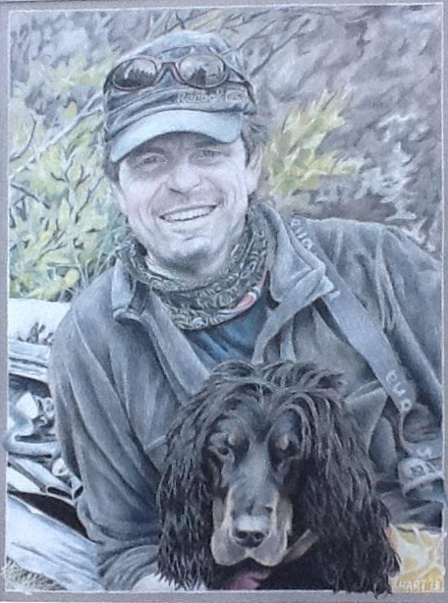
David Hart (2014)
The Love Lives On
Colored Pencil

Slide 17
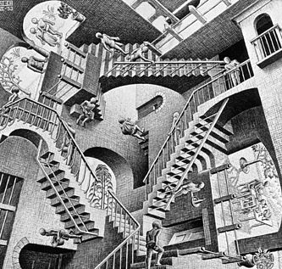
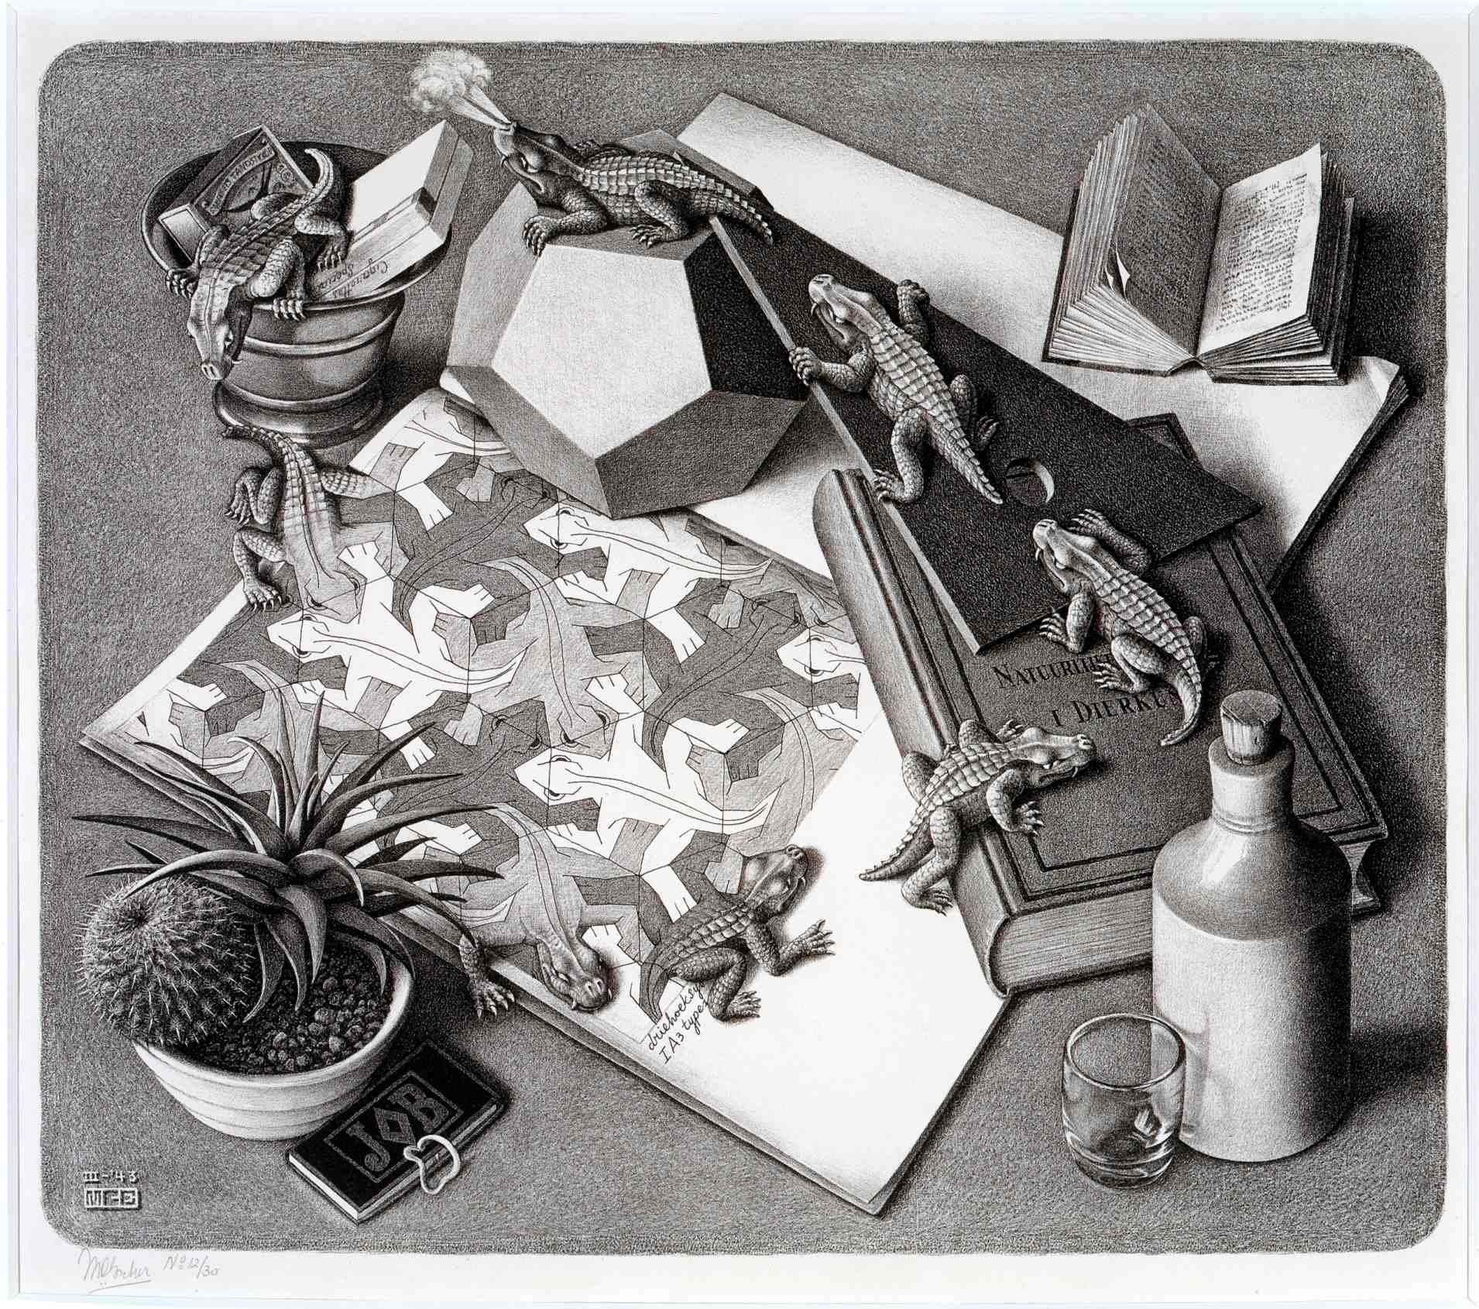
And Finally…
The drawings of illustrator MC Escher- creating illusions within incredible works of art:
https://www.youtube.com/watch?v=8jRmo7iM5vk

Slide 18
DRAWING- TACTILE EXPERIENCES:
Pick up 4 thin scraps of paper
Divide each scrap into 6 squares
Pick up the following materials and follow this plan:
PENCIL: smooth, blended value scale from light to dark
CHARCOAL/ CHALK PASTEL: smooth, blended value scale from light to dark (use a combination of colors if you want)
INK: use hatching or cross-hatching to build values from light to dark
COLORED PENCIL: gradually transition from light to dark by varying pressure and/ or overlapping light and dark colors
TIPS/ CONSIDERATIONS: consider using these strips, or applying these techniques while decorating your pages in your journal!

Slide 19
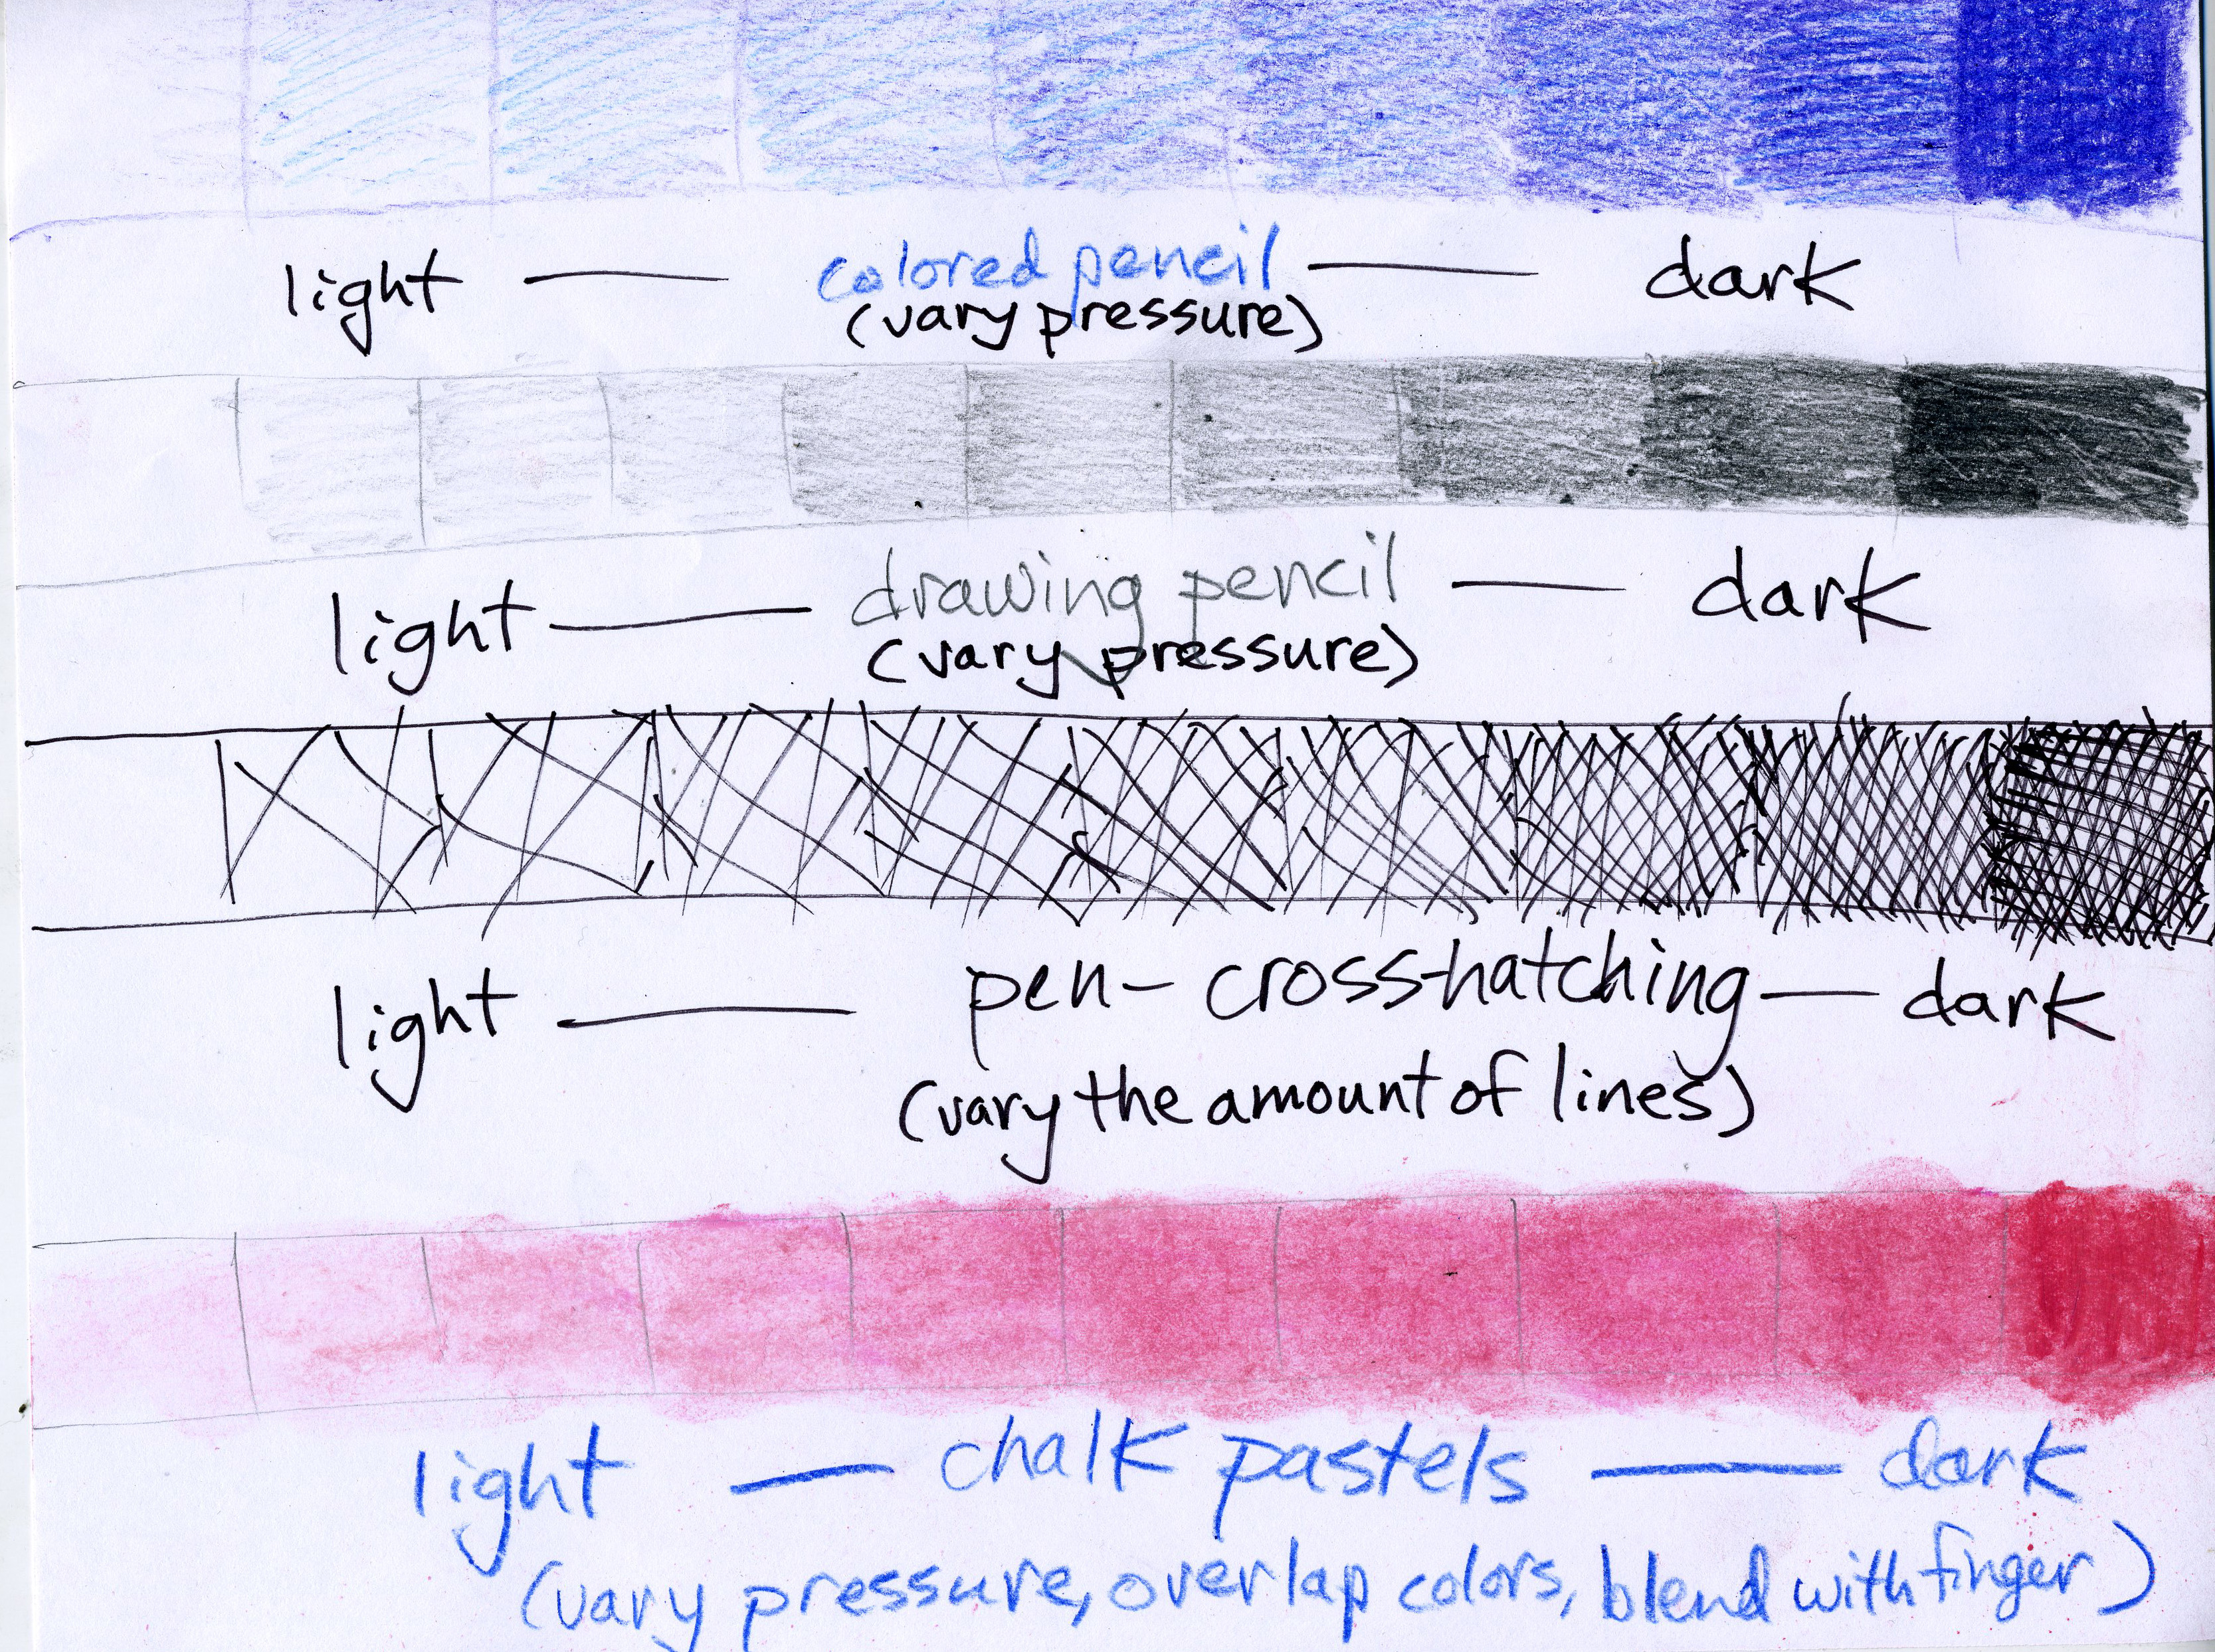
DRAWING EXAMPLE:

