Slide 1
Printmaking
What is a print made of?
  Matrix: a surface in which a design is prepared before being transferred through pressure to a receiving surface (think of a sole of a shoe in mud)
  Impression: the printed image created by a matrix
  A single matrix can be used to create many impressions, often identical, each considered an original work of art

Slide 2
What are the processes in Printmaking?
RELIEF
INTAGLIO
LITHOGRAPHY
SCREENPRINTING
MONOTYPE
COMPUTERS (we will cover this in an upcoming chapter…)

Slide 3
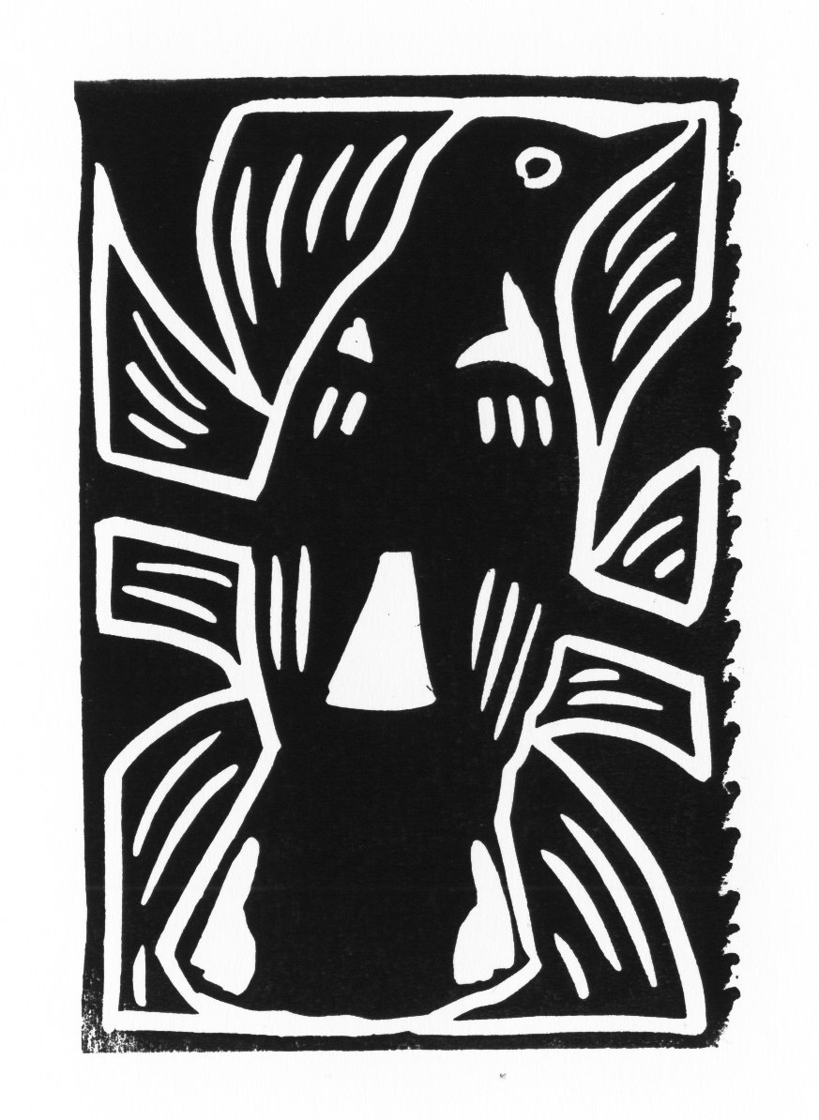
RELIEF PRINTS
Any printing method in which the image to be printed is raised from the background
Consists of the following:
  Woodcuts
  Wood Engravings
  Linocuts

Slide 4
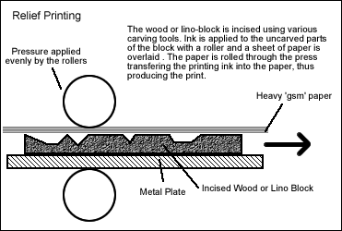
RELIEF PRINTS
WOODCUTS:
  Areas not meant to print are cut out
  When printed, only areas raised take ink
  The block is inked and pressed onto paper, to reveal a reverse version of the original

Slide 5
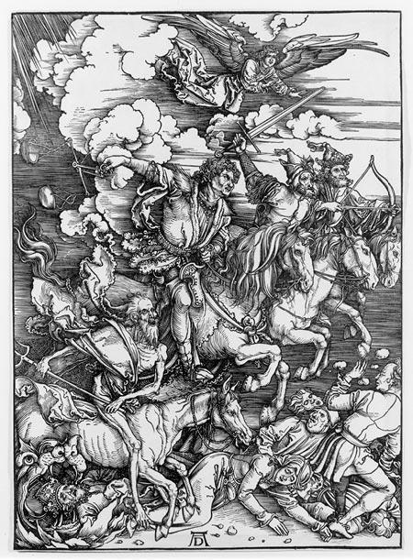
Albrecht Durer
Four Horseman of the Apocalypse

Slide 6
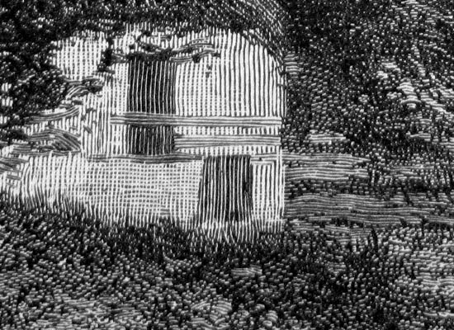
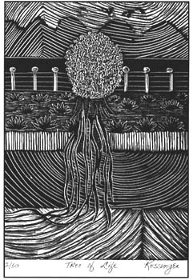
RELIEF PRINTS
Wood Engraving
  More precise than woodcuts
  Fine, detailed grooves are established
  Uses the “end grain” of the wood, which allows for more precision and detail
http://www.youtube.com/watch?v=K9O1aUrTNJs

Slide 7
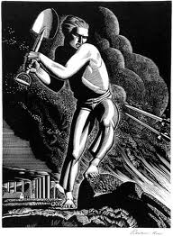
Rockwell Kent
Workers of the World, Unite!

Slide 8
RELIEF PRINTS
Linocut
  Uses a linoleum material
  The material is much softer than wood
  PROS: No grains exist, which make it easy to cut in any direction
  CONS: The block of linoleum wears down more quickly than wood

Slide 9
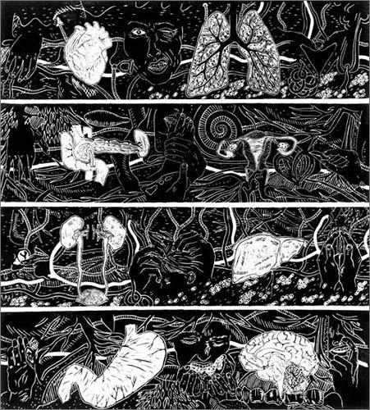
Kiki Smith
How I Know I’m Here

Slide 10
INTAGLIO PRINTS
Reverse process of the relief, in which areas meant to print are below the surface of the printing plate
The artist uses a sharp tool or acid to make the lines and grooves in a metal plate
When the plate is inked, the ink sinks into the depressions
When the paper is dampened, it is brought in contact with the image under pressure
The paper is pushed into the depressions to pick up the image
http://www.youtube.com/watch?v=QA-La4ljQIA

Slide 11
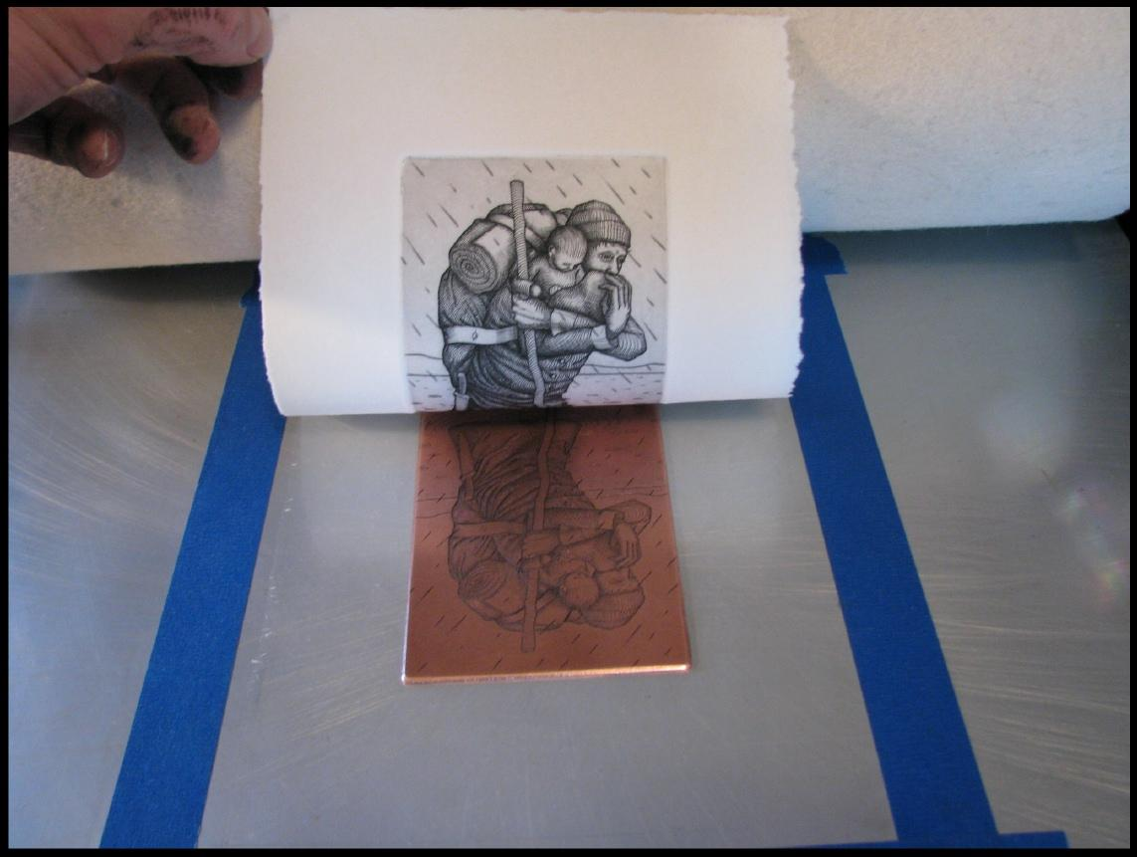
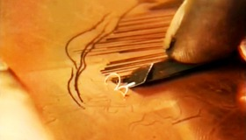
INTAGLIO PRINTS
Engraving
  Use of a burin, a sharp instrument to cut lines into a metal plate
  Very close to the look of pen and ink
  This was the principle way of reproducing and disseminating art before photography

Slide 12
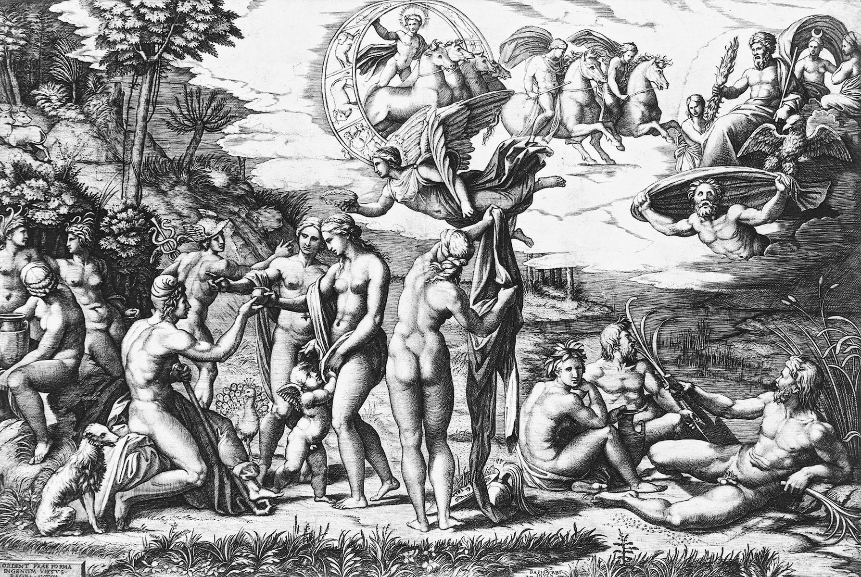
Raphael
The Judgment of Paris

Slide 13
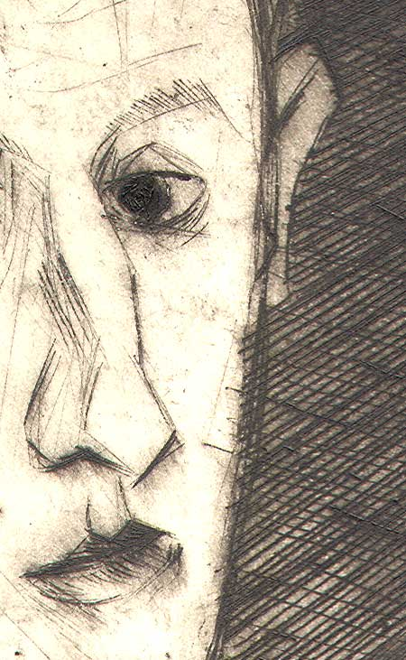
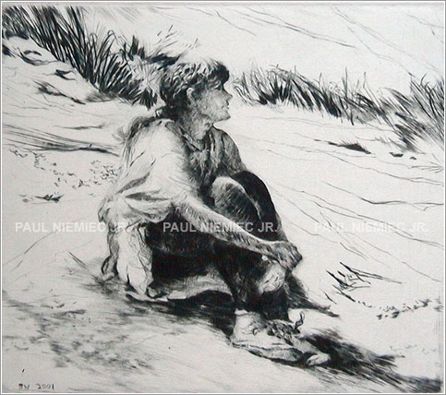
INTAGLIO PRINTS
Dry-point
  The cutting material is a dry-point needle
  As the tool scratches across the plate, it raises a burr, which holds the ink
  The process is softer and less sharply detailed than an engraved line

Slide 14
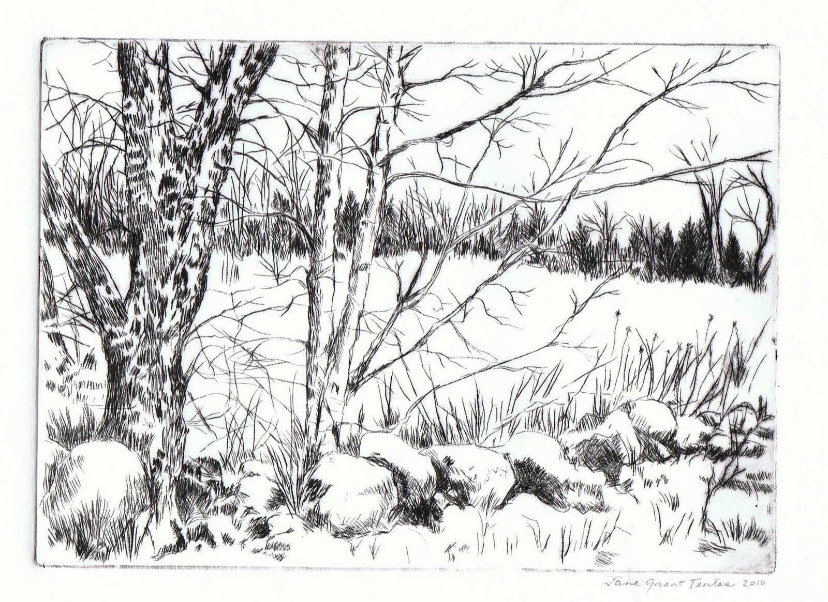

Slide 15
INTAGLIO PRINTS
Mezzotint
  Considered a “reverse process” in which you are working dark to light
STEPS OF THE PROCESS:
    Roughen plate- create spots to hold ink
    Lighten spots with a burnisher
    Create a range of values depending on the amount of pressure applied

Slide 16
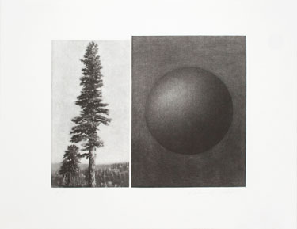
Vija Celmins
Untitled

Slide 17
INTAGLIO PRINTS
Etching
  An acid resistant substance called a ground is placed on a surface
  The design is drawn with an etching needle
  The ground is removed, exposing the bare metal
  The entire plate is dipped in acid
  The areas exposed by the needle are eaten by the acid
  The ground is removed, and the plate is inked and printed

Slide 18
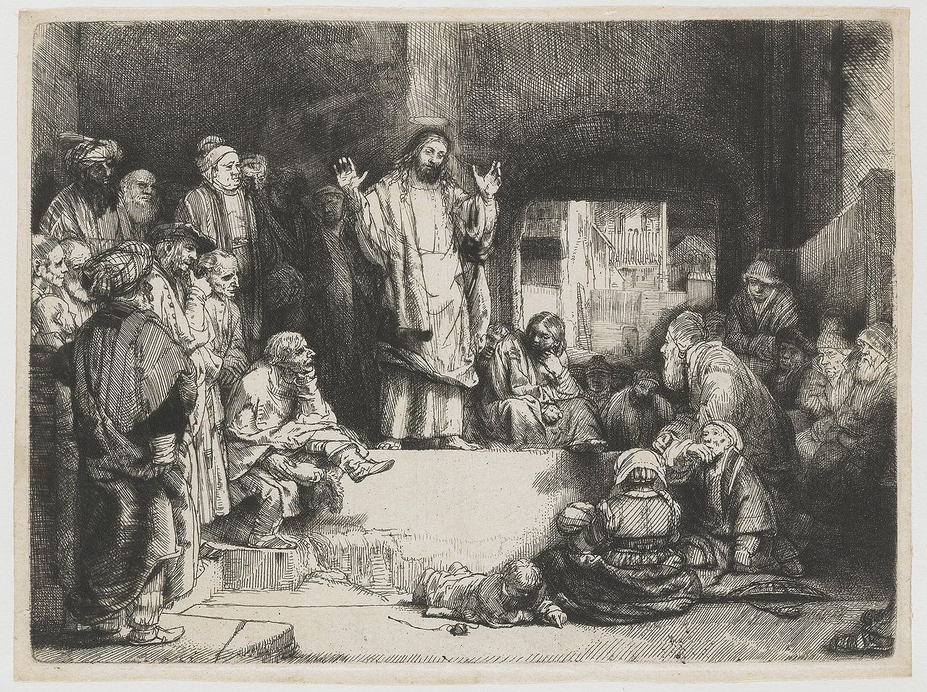
Rembrandt
Christ Preaching

Slide 19
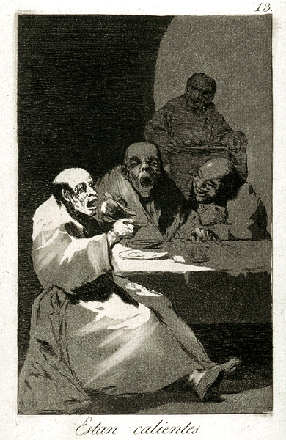
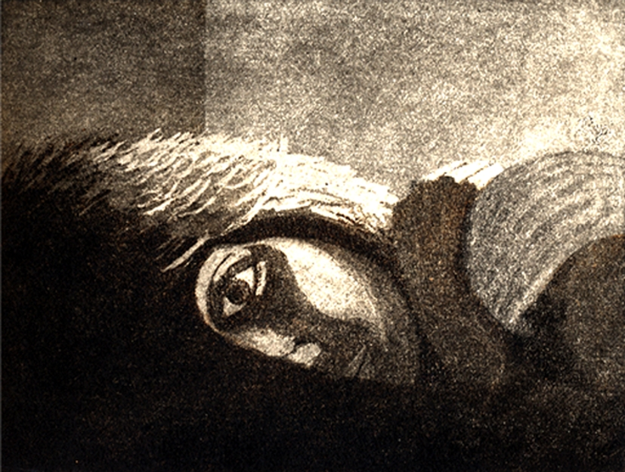
INTAGLIO PRINTS
Aquatint
  Achieve flat areas of tone
  Similar to plates of color
  The acid bites in large areas on the plate
  Often mixed with other techniques to produce lines and values

Slide 20
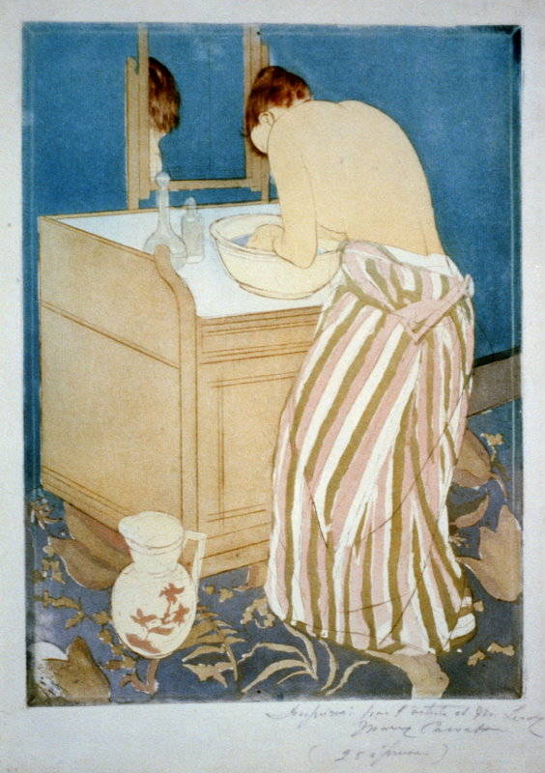
Mary Cassatt
Woman Bathing

Slide 21
INTAGLIO PRINTS
Lithography
  Considered a “planographic process” in which the whole printing surface is flat
  Relies on the principle that oil and water don’t mix
  A grease based crayon is used to draw with
  The stone is subjected to treatment in an acid solution, then the printer dampens the stone
  The end result looks much like crayon on stone
  http://www.youtube.com/watch?v=JHw5_1Hopsc

Slide 22
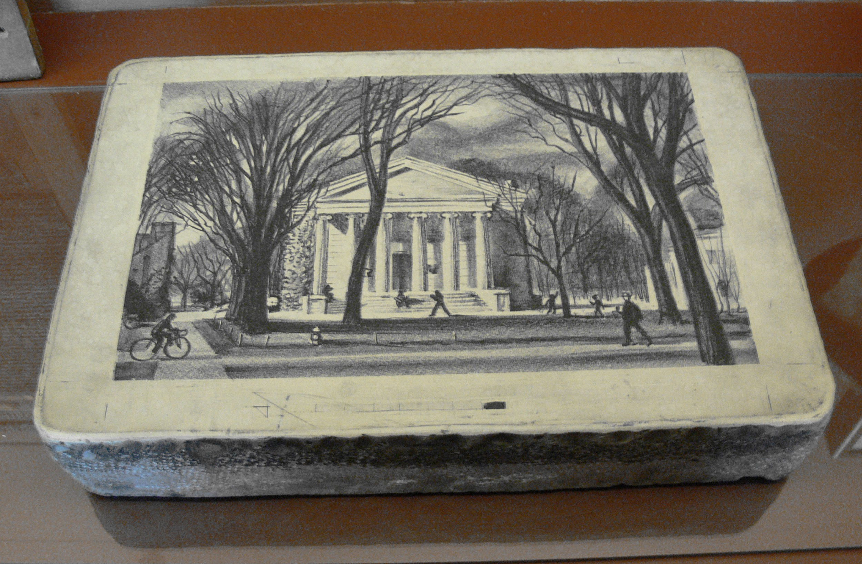
INTAGLIO PRINTS
Lithography stone:

Slide 23
SCREENPRINTING
A stencil is created on a screen
Areas are blocked out that are not meant to print
A screen is placed over the paper- and ink is forced through with a squeegee
One screen is used for each color
http://www.youtube.com/watch?v=hcixksLknbw

Slide 24
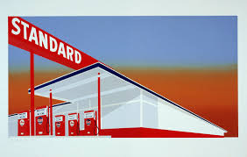
Ed Ruscha
Standard Station

Slide 25
MONOTYPE
This is the exception to the “multiple” concept of prints
Only one print results with this process
The artist draws on the metal plate or sheet of paper, dilutes the paint, and runs it through a press
The original is often destroyed through this process, and no duplicates are possible
The advantage is that colors are often unlimited, no cutting issues arise, and the artist can work quite freely!
http://www.youtube.com/watch?v=b0W6e8tZnyQ

Slide 26
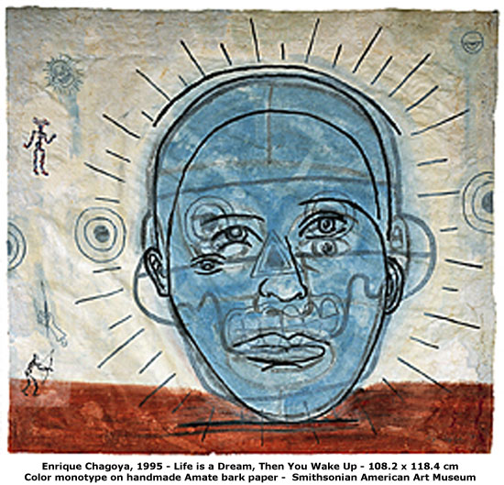
Enrique Chagoya
Life is a Dream, Then You Wake Up

Slide 27
Making a Print!
We will be making our own prints, using the RELIEF PRINT method.
Our process will be similar to the woodcut process, in which we will cut away areas that will stay white, and leave areas raised to add color or value.

Slide 28
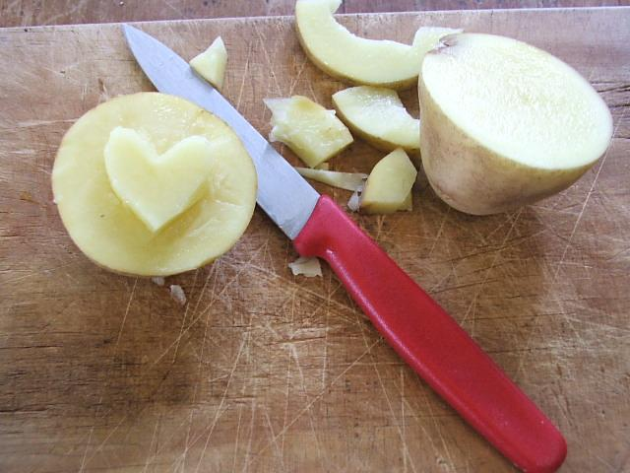
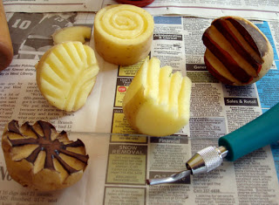
Making a Potato Print!
Begin with a sketch on paper, approximately 2” x 2”, and consider basic shapes, textures and patterns. Consider a design you can repeat as a border, or a design that can stand alone as a unique design (TIP: consider how you can work this into your journal as a design element)
We will work quickly on this, and will just use the sketch as a reference.
Begin cutting out your design on the potato with a carving tool, being careful not to cut away too much.
Brush on Paint, and Print your potato! Use construction paper and get creative with your choice of colors for paint and paper!

Slide 29
ART APPRECIATION:
Finish potato print- consider how you can use this with your website or journal!
Show me your finished potato prints! I will check these off in class (10 points).
Place wet projects on the drying rack, and dry ones in your bin.
Work on website or journal!

